Slide 1
Functions in C++
Department of Computer Science and Engineering
OOPS using C++ (Dr. Rishu Chhabra-G18)

Slide 2
C++ Functions
A function is a group of statements that together perform a task. Every C++ program has at least one function, which is main(), and all the most trivial programs can define additional functions.
Suppose we need to create a program to create a circle and color it. We can create two functions to solve this problem:
a function to draw the circle
a function to color the circle
Dividing a complex problem into smaller chunks makes our program easy to understand and reusable.
We can divide up our code into separate functions. How we divide up our code among different functions is up to us, but logically the division usually is such that each function performs a specific task.
OOPS using C++ (Dr. Rishu Chhabra-G18)

Slide 3
Function prototyping
Function prototyping is one very useful feature of C++ function. A function prototype describes the function interface to the compiler by giving details such as the number and type of arguments and the type of return values.
The prototype declaration looks just like a function definition except that it has no body i.e., its code is missing.
A declaration introduces a (function) name to the program whereas a definition is a declaration that also tells the program what the function is doing and how it is doing.
In C++, the code of function declaration should be before the function call. However, if we want to define a function after the function call, we need to use the function prototype. (shown as example in next slides)
OOPS using C++ (Dr. Rishu Chhabra-G18)

Slide 4
Function prototyping
The Function prototype serves the following purposes –
1) It tells the return type of the data that the function will return.
2) It tells the number of arguments passed to the function.
3) It tells the data types of each of the passed arguments.
4) Also it tells the order in which the arguments are passed to the function.
The function prototype specifies the input/output interlace to the function i.e. what to give to the function and what to expect from the function.
The prototype of a function is also called the signature of the function.
OOPS using C++ (Dr. Rishu Chhabra-G18)

Slide 5
Function Declaration
Function Declaration:
A function declaration tells the compiler about a function's name, return type, and parameters. A function definition provides the actual body of the function.
Define the function/Syntax to declare the function:
return_type function_name ( parameter list/ p1, p2, p3…. ) //Function Prototype
{
body of the function
}
Here are all the parts of a function:−
1. Return Type − A function may return a value. The return_type is the data type of the value the function returns. Some functions perform the desired operations without returning a value. In this case, the return_type is the keyword void.
OOPS using C++ (Dr. Rishu Chhabra-G18)

Slide 6
Function
2. Function Name − This is the actual name of the function. The function name and the parameter list together constitute the function signature.
3. Parameters − A parameter is like a placeholder. When a function is invoked, you pass a value to the parameter. This value is referred to as actual parameter or argument. The parameter list refers to the type, order, and number of the parameters of a function. Parameters are optional; that is, a function may contain no parameters.
4. Function Body − The function body contains a collection of statements that define what the function does.
OOPS using C++ (Dr. Rishu Chhabra-G18)

Slide 7
Example for Defining the function
// function returning the max between two numbers
  int max (int num1, int num2) //Declaration of function
  { // local variable declaration
  int result;
  if (num1 > num2)
  result = num1;
  else
  result = num2;
  return result;
  }
  Function declaration is required when you define a function in one source file and you call that function in another file. In such case, you should declare the function at the top of the file calling the function.
OOPS using C++ (Dr. Rishu Chhabra-G18)

Slide 8
Calling a Function
While creating a C++ function, you give a definition of what the function has to do. To use a function, you will have to call or invoke that function.
When a program calls a function, program control is transferred to the called function. A called function performs defined task and when it’s return statement is executed or when its function-ending closing brace is reached, it returns program control back to the main program.
To call a function, you simply need to pass the required parameters along with function name, and if function returns a value, then you can store returned value.
OOPS using C++ (Dr. Rishu Chhabra-G18)

Slide 9
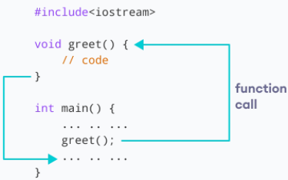
Calling a Function
In the below program, we have declared a function named greet(). To use the greet() function, we need to call it.
OOPS using C++ (Dr. Rishu Chhabra-G18)

Slide 10
Example of Calling Function
#include <iostream>
using namespace std;
// function declaration and function prototype
int max(int num1, int num2);
int main () {
// local variable declaration:
int a = 100;
int b = 200;
int ret;
// calling a function to get max value.
ret = max(a, b);
cout << "Max value is : " << ret << endl;
return 0;
}
// function returning the max between two numbers
int max(int num1, int num2) {
// local variable declaration
int result;
if (num1 > num2)
result = num1;
else
result = num2;
return result;
}
OOPS using C++ (Dr. Rishu Chhabra-G18)

Slide 11
Inline functions
Inline function is a function that is expanded in line when it is called. When the inline function is called whole code of the inline function gets inserted or substituted at the point of inline function call. This substitution is performed by the C++ compiler at compile time.
Inline functions are commonly used when the function definitions are small, and the functions are called several times in a program. Using inline functions saves time to transfer the control of the program from the calling function to the definition of the called function.
C++ inline function is powerful concept that is commonly used with classes. If a function is inline, the compiler places a copy of the code of that function at each point where the function is called at compile time.
Any change to an inline function could require all clients of the function to be recompiled because compiler would need to replace all the code once again otherwise it will continue with old functionality.
OOPS using C++ (Dr. Rishu Chhabra-G18)

Slide 12
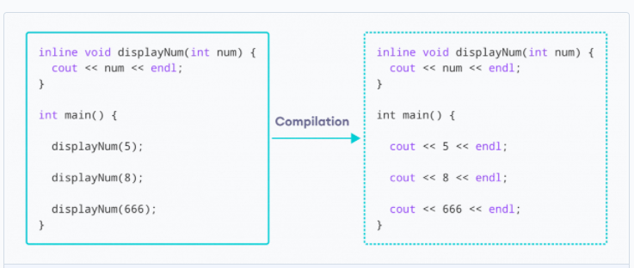
Inline functions
To inline a function, place the keyword inline before the function name and define the function before any calls are made to the function. The compiler can ignore the inline qualifier in case defined function is more than a line.
A function definition in a class definition is an inline function definition, even without the use of the inline specifier.
OOPS using C++ (Dr. Rishu Chhabra-G18)

Slide 13
Function Overloading
Function Overloading is defined as the process of having two or more function with the same name, but different type and number in parameters is known as function overloading in C++.
In function overloading, the function is redefined by using either different types of arguments or a different number of arguments. It is only through these differences compiler can differentiate between the functions.
The advantage of Function overloading is that it increases the readability of the program because you don't need to use different names for the same action.
// same name different arguments
int test() { }
int test(int a) { }
float test(double a) { }
int test(int a, double b) { }
OOPS using C++ (Dr. Rishu Chhabra-G18)

Slide 14
Example
#include <iostream>
using namespace std;
// function with 2 parameters
void display(int var1, double var2)
{
cout << "Integer number: " << var1;
cout << " and double number: " << var2 << endl;
}
// function with double type single parameter
void display(double var)
{
cout << "Double number: " << var << endl;
}
// function with int type single parameter
void display(int var)
{
cout << "Integer number: " << var << endl;
}
int main()
{
int a = 5;
double b = 5.5;
// call function with int type parameter
display(a);
// call function with double type parameter
display(b);
// call function with 2 parameters
display(a, b);
return 0;
}
OOPS using C++ (Dr. Rishu Chhabra-G18)

Slide 15
Function Parameters
Information can be passed to functions as a parameter. Parameters act as variables inside the function. Parameters are specified after the function name, inside the parentheses.
You can add as many parameters as you want, just separate them with a comma:
Syntax
void functionName(parameter1, parameter2, parameter3)
{
// code to be executed
}
Parameters can be Actual parameters or Formal Parameters.
The key difference between Actual Parameters and Formal Parameters is that Actual Parameters are the values that are passed to the function when it is invoked while
OOPS using C++ (Dr. Rishu Chhabra-G18)

Slide 16
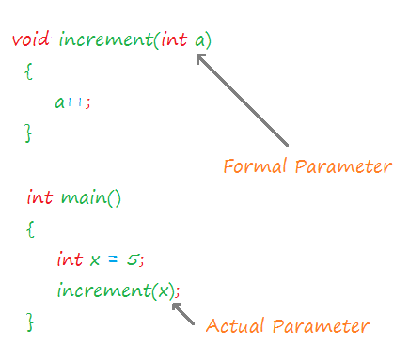
Example
Formal Parameters are the variables defined by the function that receives values when the function is called.
OOPS using C++ (Dr. Rishu Chhabra-G18)

Slide 17
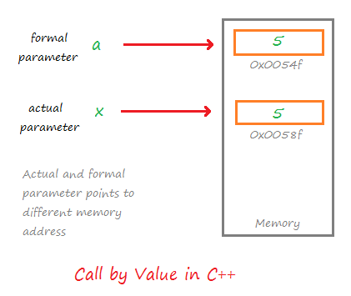
Call By Value
When a function is called in the call by value, the value of the actual parameters is copied into formal parameters.
Both the actual and formal parameters have their own copies of values, therefore any change in one of the types of parameters will not be reflected by the other.
This is because both actual and formal parameters point to different locations in memory (i.e. they both have different memory addresses).
Call by value method is useful when we do not want the values of the actual parameters to be changed by the function that has been invoked.
OOPS using C++ (Dr. Rishu Chhabra-G18)

Slide 18
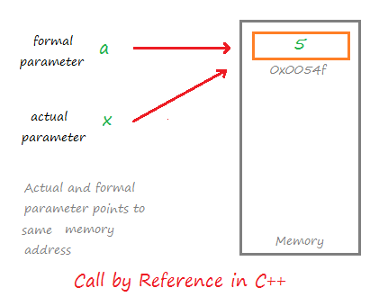
Call By Reference
In the call by reference, both formal and actual parameters share the same value. In the call by reference, both formal and actual parameters share the same value.
That means any change on one type of parameter will also be reflected by other.
Calls by reference are preferred in cases where we do not want to make copies of objects or variables, but rather we want all operations to be performed on the same copy.
OOPS using C++ (Dr. Rishu Chhabra-G18)

Slide 19
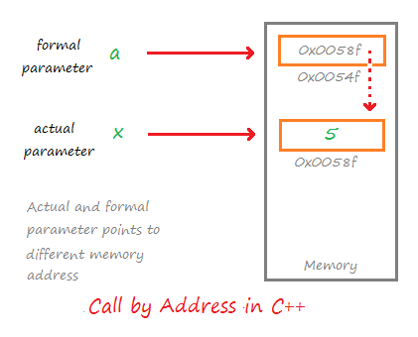
Call by Address
In the call by address method, both actual and formal parameters indirectly share the same variable.
In this type of call mechanism, pointer variables are used as formal parameters.
The formal pointer variable holds the address of the actual parameter, hence the changes done by the formal parameter is also reflected in the actual parameter.
As demonstrated in the diagram, both parameters point to different locations in memory, but since the formal parameter stores the address of the actual parameter, they share the same value.
OOPS using C++ (Dr. Rishu Chhabra-G18)

Slide 20
Call By Pointers
The call by pointer method of passing arguments to a function copies the address of an argument into the formal parameter.
Inside the function, the address is used to access the actual argument used in the call. This means that changes made to the parameter affect the passed argument.
To pass the value by pointer, argument pointers are passed to the functions just like any other value.
So accordingly you need to declare the function parameters as pointer types as in the following function swap(), which exchanges the values of the two integer variables pointed to by its arguments.
OOPS using C++ (Dr. Rishu Chhabra-G18)

Slide 21
Call By Pointers
// function definition to swap the values.
void swap(int *x, int *y)
{
int temp;
temp = *x; /* save the value at address x */
*x = *y; /* put y into x */
*y = temp; /* put temp into y */
return;
}
OOPS using C++ (Dr. Rishu Chhabra-G18)

Slide 22
Example
#include <iostream>
using namespace std;
// function declaration
void swap(int *x, int *y);
int main ()
{
// local variable declaration:
int a = 100;
int b = 200;
cout << "Before swap,
value of a :" << a << endl;
cout << "Before swap,
value of b :" << b << endl;
/* calling a function to swap the values.
* &a indicates pointer to a ie. address of variable a and * &b indicates pointer to b ie. address of variable b.
*/
swap(&a, &b);
cout << "After swap, value of a :" << a << endl;
cout << "After swap, value of b :" << b << endl;
return 0;
}
OOPS using C++ (Dr. Rishu Chhabra-G18)

Slide 23
Return by Reference
A C++ program can be made easier to read and maintain by using references rather than pointers. A C++ function can return a reference in a similar way as it returns a pointer.
When a function returns a reference, it returns an implicit pointer to its return value. This way, a function can be used on the left side of an assignment statement.
{
cout << "vals[" << i << "] = ";
cout << vals[i] << endl;
}
setValues(1) = 20.23; // change 2nd element
setValues(3) = 70.8; // change 4th element
cout << "Value after change" << endl;
for ( int i = 0; i < 5; i++ ) {
cout << "vals[" << i << "] = ";
cout << vals[i] << endl;
}
return 0;
}
#include <iostream>
#include <ctime>
using namespace std;
double vals[] = {10.1, 12.6, 33.1, 24.1, 50.0};
double& setValues( int i ) {
return vals[i]; // return a reference to the ith element
}
// main function to call above defined function.
int main () {
cout << "Value before change" << endl;
for ( int i = 0; i < 5; i++ )
OOPS using C++ (Dr. Rishu Chhabra-G18)

Slide 24
Default arguments
In C++ programming, we can provide default values for function parameters.
If a function with default arguments is called without passing arguments, then the default parameters are used.
However, if arguments are passed while calling the function, the default arguments are ignored.
OOPS using C++ (Dr. Rishu Chhabra-G18)

Slide 25
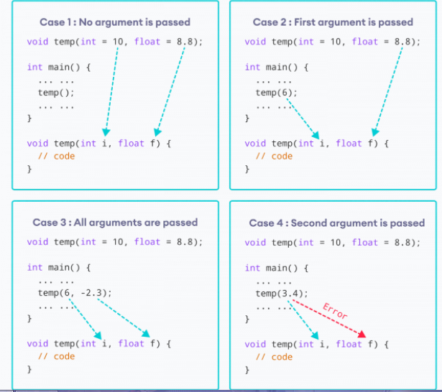
Example
OOPS using C++ (Dr. Rishu Chhabra-G18)

Slide 26
Default arguments
When temp() is called, both the default parameters are used by the function.
When temp(6) is called, the first argument becomes 6 while the default value is used for the second parameter.
When temp(6, -2.3) is called, both the default parameters are overridden, resulting in i = 6 and f = -2.3.
When temp(3.4) is passed, the function behaves in an undesired way because the second argument cannot be passed without passing the first argument.
Therefore, 3.4 is passed as the first argument. Since the first argument has been defined as int, the value that is actually passed is 3.
OOPS using C++ (Dr. Rishu Chhabra-G18)

Slide 27
Assignment
Question 1: Consider an ATM. An ATM is a class. It’s machine which is pretty much useless until you insert your debit card. After you insert your debit card, the machine has information about you and your bank account and the balance in it, so at this point it is an object. You have used a class and created an object, now you can perform operations on it like withdrawal of money or checking you balance or getting statement of your account, these operations will be methods belonging to that class (ATM) but you cannot use them until you create an object out of it.
And when you did perform whatever operation you wanted to perform and clicked exit/cancel and removed your card, you just destroyed the object. Now it is not an object, it has methods and all (the functions an ATM can perform) but you cannot use them until you insert your card again and create an object.
OOPS using C++ (Dr. Rishu Chhabra-G18)

Slide 28
THANK YOU
OOPS using C++ (Dr. Rishu Chhabra-G18)

